Slide 1

Date: | Human Biology Year 12 ATAR
Do Now Do the practice exam question provided. Lesson Agenda 1: Do Now 2: Growth Hormone: production, effects and regulation 3: Start on the Review Worksheet Provided 4: Lesson summary and wind-up Suggested Study Read through today’s notes and textbook section, especially any flow diagrams showing hormone regulation. Finish the Review Worksheet, and mark and correct your work using the answer key. NEXT LESSON Formative Assessment question (closed book, under test conditions) The Thyroid | Learning Aims Explain where Growth Hormone is produced. List the effects on the body of Growth Hormone. Describe in in detail how Growth Hormone is regulated. Discuss the disorders caused by Growth Hormone hyper- and hypo-secretion
 | Key Vocabulary Somatostatin Hypersecretion Hyposecretion

Slide 2

Growth Hormone
Production, Effects, Regulation and Disease
Ch 2 Human Perspectives

Slide 3
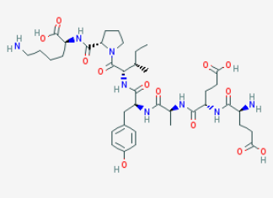
Growth Hormone
Also called somatotropin
Peptide Hormone (protein/amine group)
Produced by Anterior Pituitary and released into blood
Variety of effects related to growth and development
Learning Aim: Explain where Growth Hormone is produced.

Slide 4
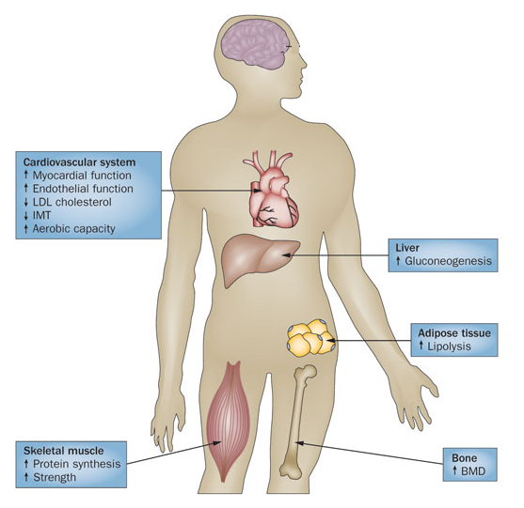
Effects of Growth Hormone
Anabolic: “builds up” tissues
Acts with a specific receptor on cell surface
Increases:
Height (bone and muscle growth) in children and adolescents
protein synthesis
metabolism of fats
Muscle mass
Bone mineralization and density
Growth of internal organs (but not brain)
Acts on liver to increase blood glucose:
Reduces uptake of glucose by liver
Increases gluconeogenesis
Learning Aim: List the effects on the body of Growth Hormone.

Slide 5
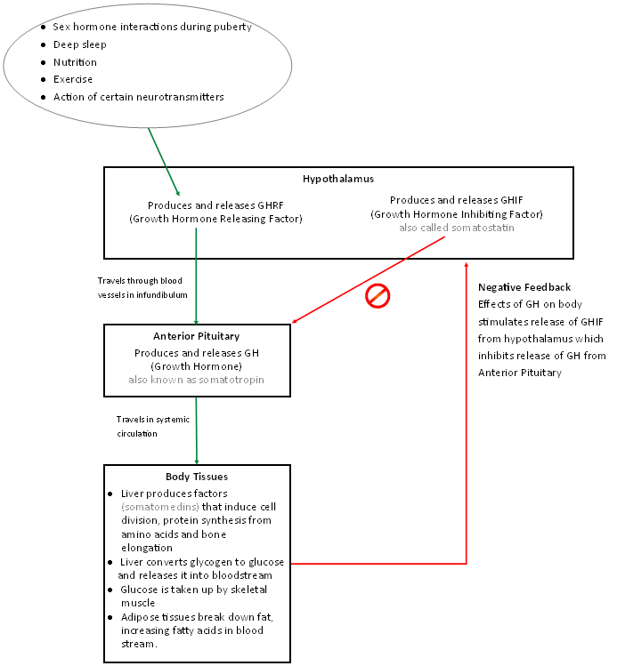
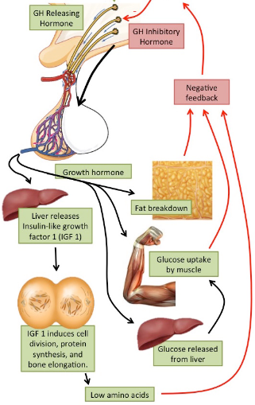
Growth Hormone Regulation
Learning Aim: Describe in in detail how Growth Hormone is regulated.

Slide 6
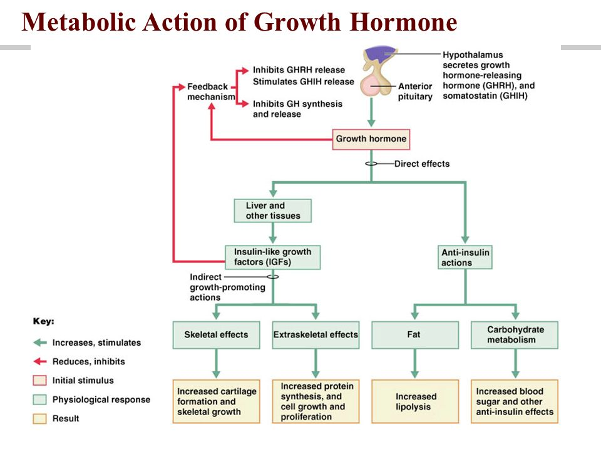
Learning Aim: Describe in in detail how Growth Hormone is regulated.

Slide 7
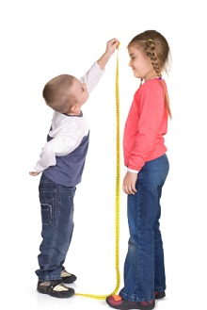
Growth Hormone Imbalance and Disease
Problems with Growth Hormone production affect homeostasis, causing disease.
Growth Hormone Hypersecretion: too much growth hormone.
Growth Hormone Deficiency: not enough growth hormone.

Slide 8
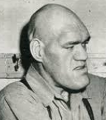

Growth Hormone Hypersecretion
Common Cause(s) | Symptoms | Diagnosis | Treatment
Commonly: Benign tumours on anterior pituitary gland causing oversecretion of Growth Hormone. Occasionally: as a result of inherited diseases or chromosomal abnormalities | Adults: Acromegaly Larger than proportion hands and feet Thick toes and fingers Prominent jaw and forehead Coarse facial features Sweating Headaches Weakness/fatigue Insomnia | Blood test for Insulin-Like Growth Factor Glucose tolerance test MRI to confirm presence of pituitary tumour(s) | Targeted radiation therapy to shrink tumours Microsurgery to remove tumours Somatostatin medication to inhibit GH release
 | Children: Gigantism As above, but greater than normal height also.
Learning Aim: Discuss the disorders caused by Growth Hormone hyper- and hypo-secretion

Slide 9
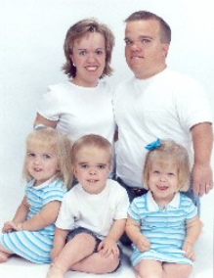
Growth Hormone Deficiency
Common causes | Symptoms | Diagnosis | Treatment
Often no cause can be established in children Can go together with other pituitary diseases Childhood onset may be due to: Heritable gene mutations Congenital disease or malformation Adult onset may be due to pituitary damage from Radiation Surgery Autoimmune attack of pituitary | Childhood onset: Short stature – may be proportional or non-proportional. Slow growth rate. Slower muscle development. Unusual facial features – prominent forehead. Adult onset: Decrease in muscle and bone mass Heart problems Baldness (men) Decreased energy and strength | Blood test to look for abnormally low growth hormone levels. | Treatment with injections of growth hormone. Recombinant gene technology Gene to produce growth hormone spliced into bacteria Genetically engineered growth hormone produced by bacteria (more on this later)
Learning Aim: Discuss the disorders caused by Growth Hormone hyper- and hypo-secretion

